Slide 1


Teknologi Telematika
Pasca Sarjana
Magister Komputer
UNIVERSITAS BUDI LUHUR
Hari soetanto
2014

Slide 2
Tujuan
Pengenalan tentang ciri-ciri komputer pada umumnya
Pemanfaatan teknologi informasi pada organisasi yang menggunakan komputer.
Kemampuan dan keterbatasan sistem pengolahan data dengan memperhatikan faktor-faktor ekonomis dan efektivitas.
Pengetahuan tentang konsep dan pengelo­laan sumber daya dalam komputer, dan gambaran dalam fasilitas sistem operasi untuk kemudahan menggunakan komputer.

Slide 3
SASARAN:
Mengenal era informasi, perkembangan komputer, dan kegunaannya
Mengenal aplikasi dan sistem perangkat lunak, unit pemrosesan, perangkat input dan output, media penyimpanan, jaringan, basis data, sistem informasi, dan implikasi dari era teknologi informasi.

Slide 4
Bahasan
Introduction
Introduction to computers
Internet and WWW
Application software
Components of the system unit
Computer
Input
Output
Storage
Operating system & utility program
Database management

Slide 5
Bahasan 2
Computer (2)
Communications & networks
Computer security, ethics & privacy
Information system and development
Program language & program development
TEST / Tugas

Slide 6

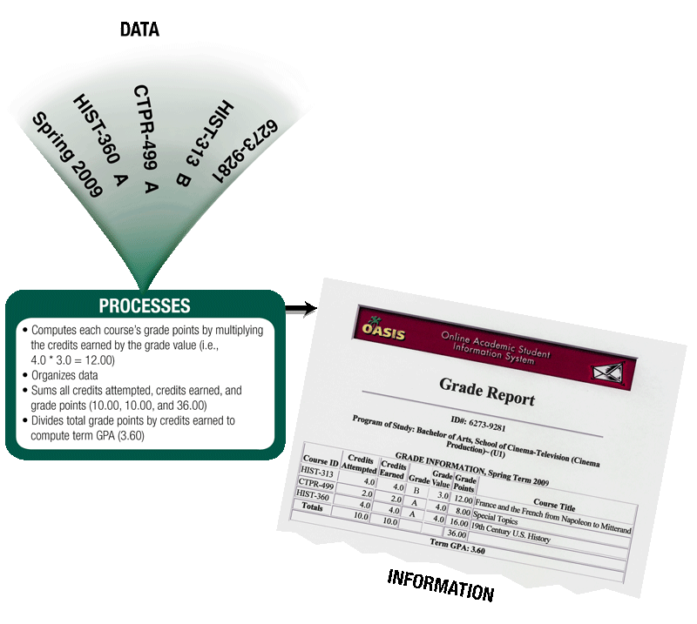
Introduction to computers
How is a computer defined?
Electronic device operating under the control of instructions stored in its own memory
Data
Information
Produces and stores result

Slide 7
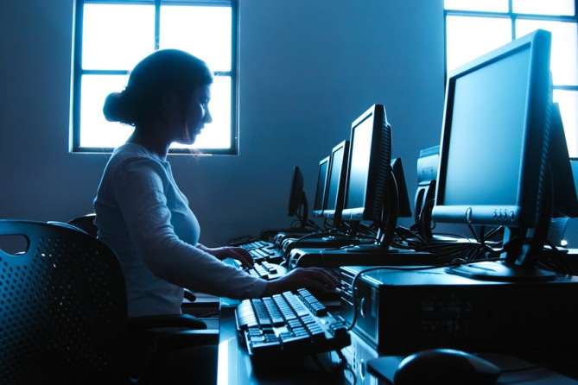
Introduction to computers
What is computer literacy (digital literacy)?
Current knowledge and understanding of computers and their uses
Computers are everywhere
What is the information processing cycle?
Input
Process
Output
Storage
Communication

Slide 8
Information processing cycle
What is an input device?
Hardware used to enter data and instructions
What is an output device?
Hardware that conveys information to one or more people
What is the system unit?
Case that contains the electronic components of the computer that are used to process data
Input
Proses
Ouput

Slide 9
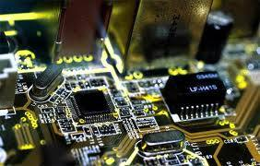
The Components of a Computer
What is an input device?
Hardware used to enter data and instructions
What is an output device?
Hardware that conveys information to one or more people
What is the system unit?
Case that contains the electronic components of the computer that are used to process data

Slide 10
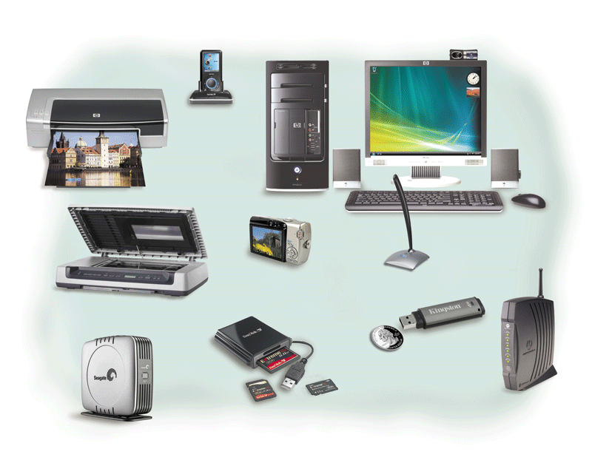

Slide 11
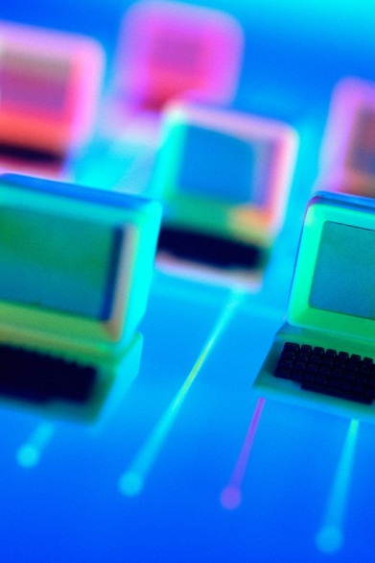
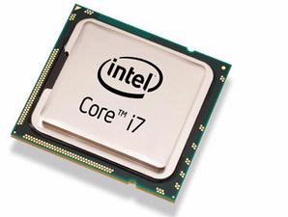
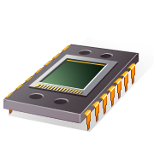
What are two main components on the motherboard?
Processor
Also called a Central Processing Unit (CPU)
The electronic component that interprets and carries out the basic instructions that operate the computer
Memory
Consists of electronic components that store instructions waiting to be executed and data needed by those instructions

Slide 12
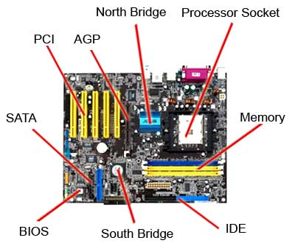
Motherboard

Slide 13
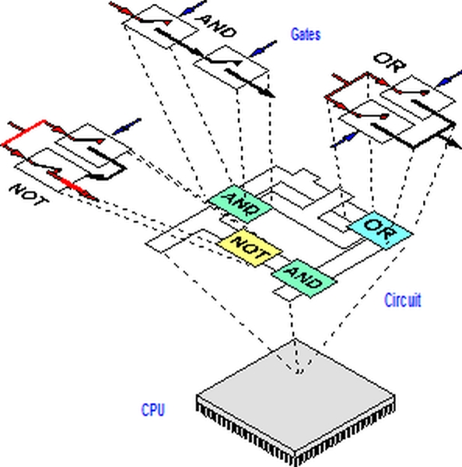
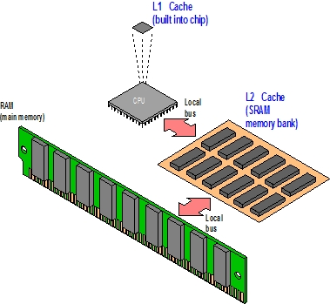

Slide 14
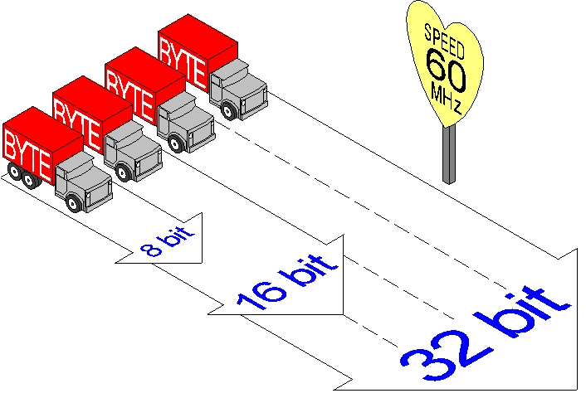

Slide 15
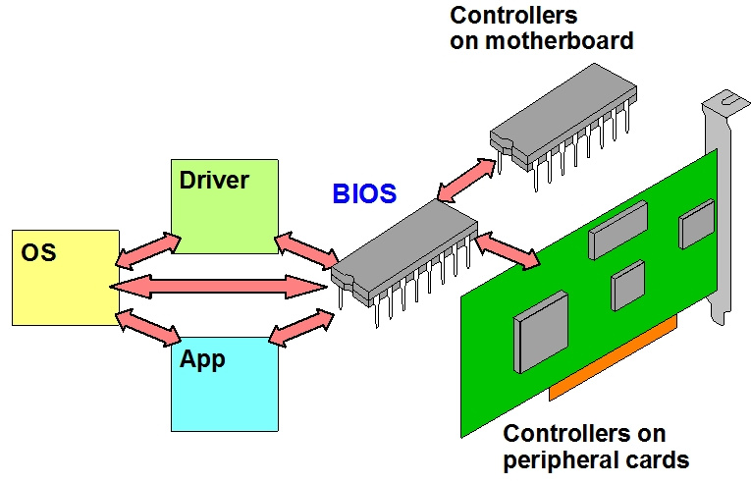

Slide 16
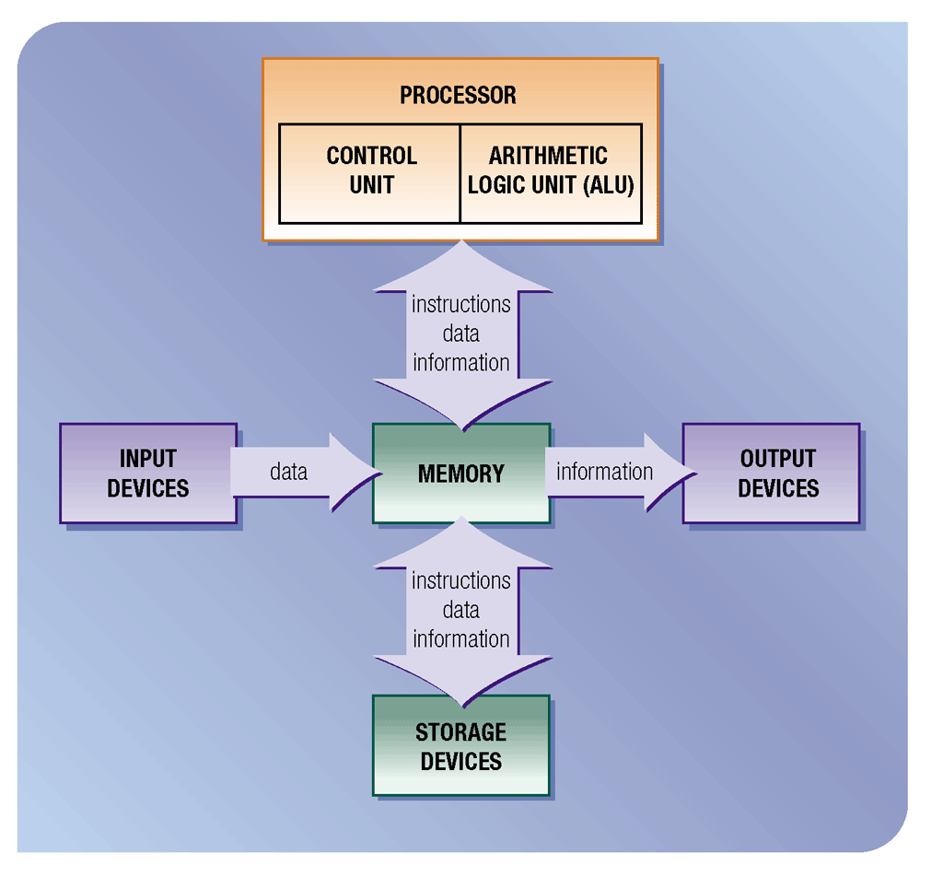

Slide 17
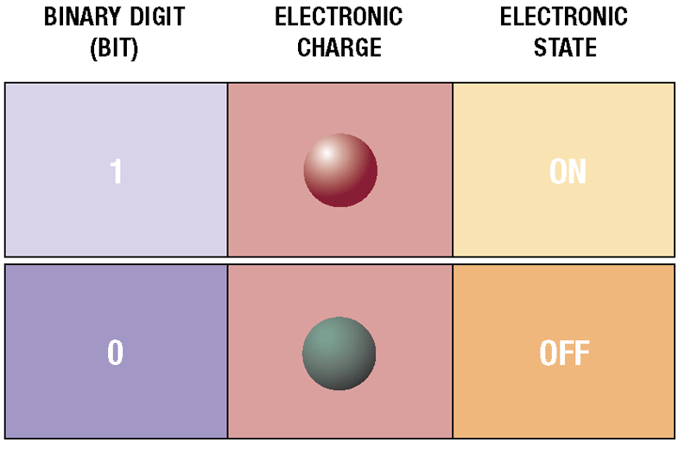
Data Representation
Recognize only two discrete states: on or off
Use a binary system to recognize two states
Use Number system with two unique digits: 0 and 1, called bits (short for binary digits)

Slide 18
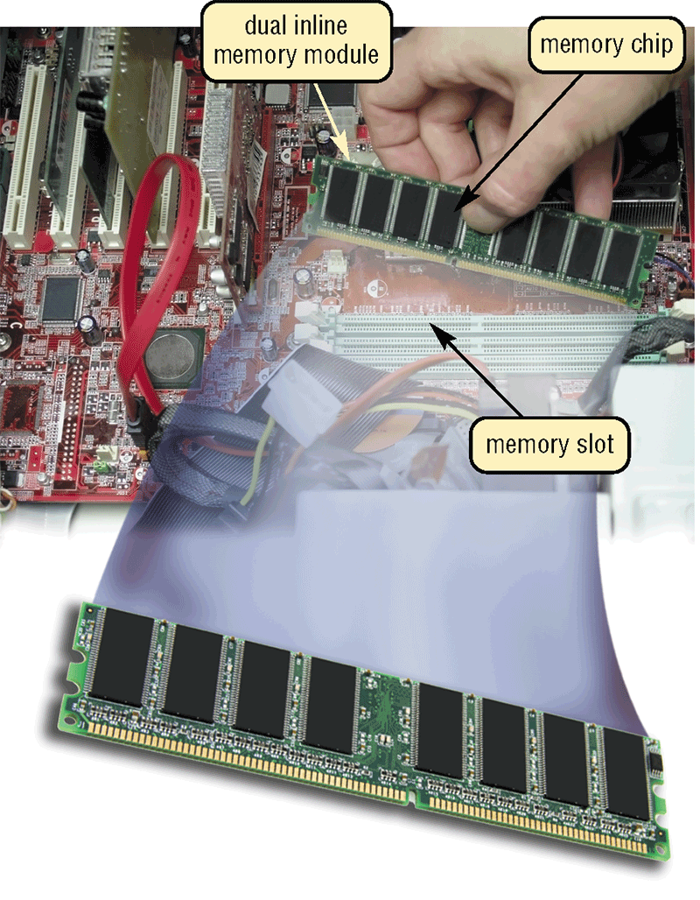
Memori

Slide 19
Bytes
Value | Metric
1000 | kB | kilobyte
1000² | MB | megabyte
1000³ | GB | gigabyte
1000⁴ | TB | terabyte
1000⁵ | PB | petabyte
1000⁶ | EB | exabyte
1000⁷ | ZB | zettabyte
1000⁸ | YB | yottabyte

Slide 20
What is storage?
Holds data, instructions, and information for future use
Storage Media
Storage Device
Notes:
Storage media untuk menyimpan data, perintah dan informasi spt: floppy disk, USB, Hardisk, cd,dvd dan memori card
Storage device merekam dan atau mendapatkan kembali berbagai hal ke dan dari media penyimpanan

Slide 21
What is storage?
Storage Media
Berbentuk fisik dimana data, instruksi, dan informasi yang disimpan spt: floppy disk, USB, Hardisk, cd,dvd dan memori card
Storage Device
Storage device : merekam dan atau mendapatkan kembali berbagai hal ke dan dari media penyimpanan
Notes:
Storage media untuk menyimpan data, perintah dan informasi spt: floppy disk, USB, Hardisk, cd,dvd dan memori card
Storage device merekam dan atau mendapatkan kembali berbagai hal ke dan dari media penyimpanan

Slide 22
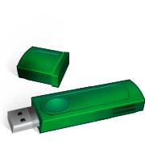
What is a USB flash drive?
Portable storage device
Small and lightweight enough to be transported on a keychain or in a pocket
The average USB flash drive can hold about 2 billion characters

Slide 23
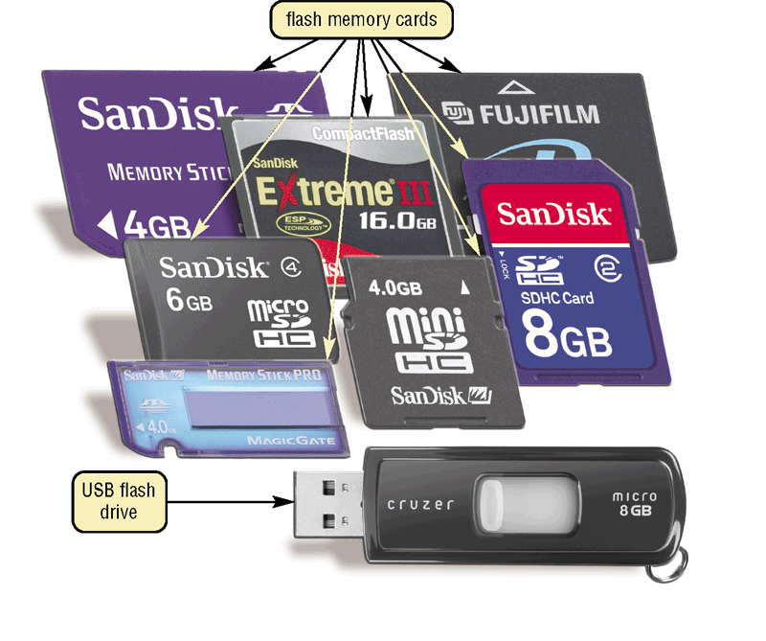

Slide 24
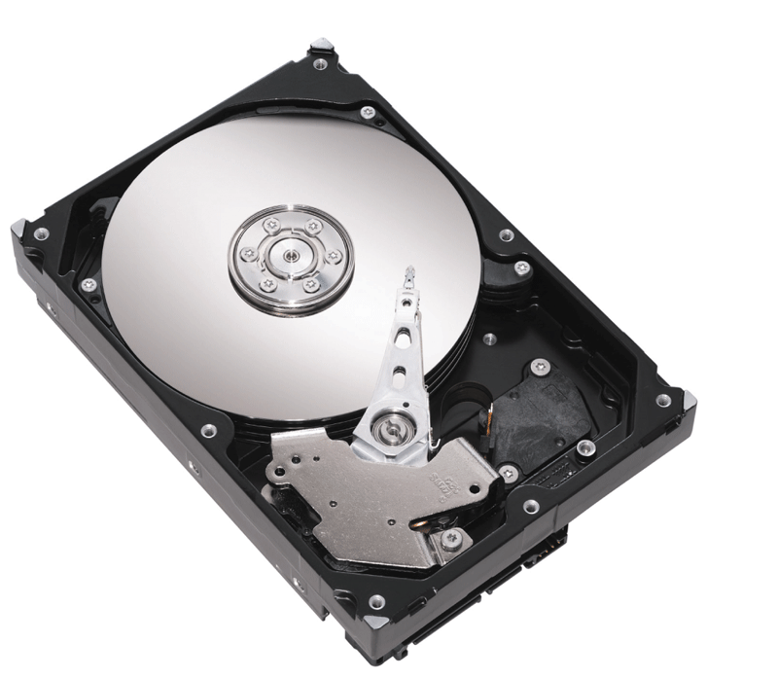
What is a hard disk?
Menyediakan kapasitas penyimpanan yang lebih besar dari pada USB flash drive
Most are housed inside the system unit

Slide 25
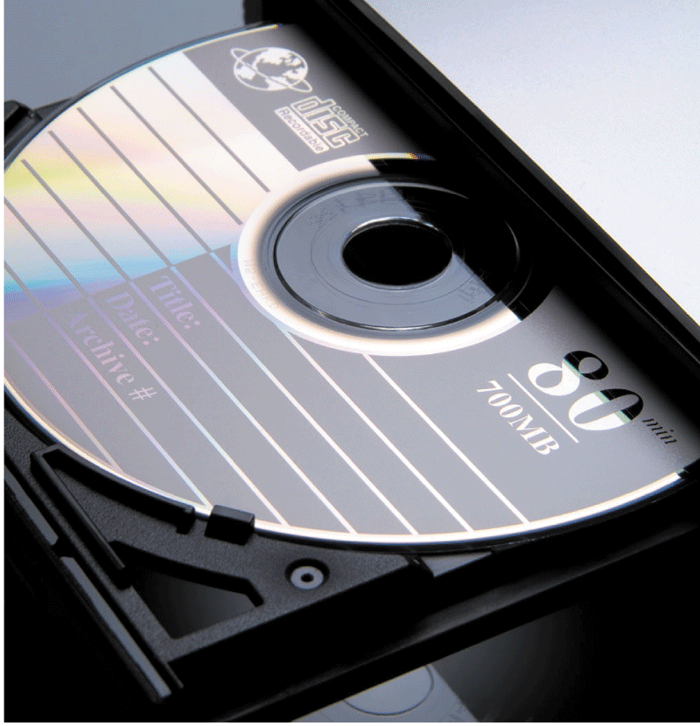
What is a compact disc?
Flat, round, portable metal disc
CD
DVD
HD-DVD
Blu-ray

Slide 26
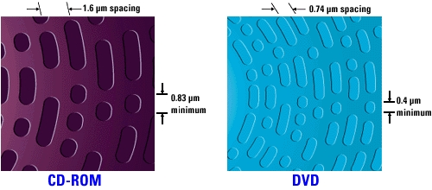

Slide 27
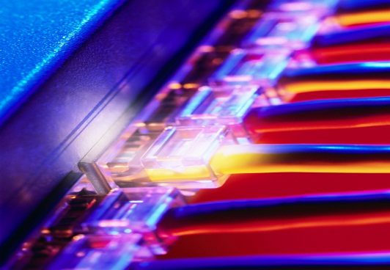
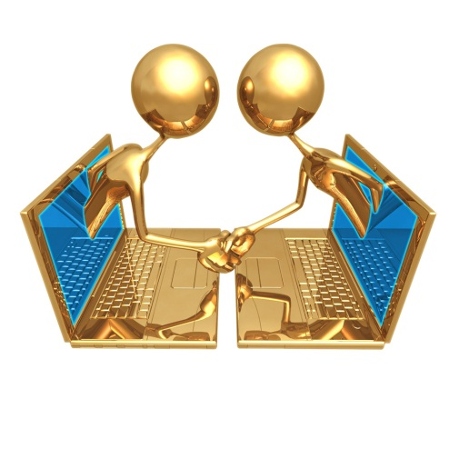
What is a communications device?
Hardware component that enables a computer to send and receive data, instructions, and information
Occurs over cables, telephone lines, cellular radio networks, satellites, and other transmission media

Slide 28

Advantages and Disadvantages of Using Computers
What are the advantages of using computers?
Speed
Reliability
Consistency
Storage
communications

Slide 29
Keuntungan
Kecepatan:
operasi komputer terjadi melalui sirkuit elektronik. Ketika data, dan perintah serta informasi mengalir / berpindah dengan kecepatan luarbiasa.
Komputer memproses milaran atau triliunan operasi dalam satu detiknya
Reliability
Consistency
Storage
communications
Speed

Slide 30
Keuntungan
Dapat dipercaya
Komponen elektronik pada komputer modern dapat diandalkan dan dipercaya, karena komponen tersebut jarang rusak
Reliability
Consistency
Storage
communications
Speed

Slide 31
Keuntungan
Konsistensi:
Dengan diberikan input dan proses yang sama, komputer akan men-produksi hasil yang sama- secara konsisten
Komputer menghasilkan hasil yang bebas dari kesalahan asalkan input dan proses di kerjakan dengan benar
Reliability
Consistency
Storage
communications
Speed

Slide 32
Keuntungan
Reliability
Consistency
Storage
communications
Speed
Penyimpanan:
Komputer menyimpan jumlah data yang banyak dan membuat data ini tersedia untuk diproses kapanpun di butuhkan

Slide 33
Keuntungan
Komunikasi:
Dapat berkomunikasi antar komputer bahkan tanpa kabel
Pengguna dimungkinkan saling berkomunikasi
Reliability
Consistency
Storage
communications
Speed

Slide 34

Advantages and Disadvantages of Using Computers
What are the disadvantages of using computers?
Violation of Privacy
Public Safety
Impact on Labor Force
Health Risks
Impact on Environment

Slide 35

Kerugian
Violation of Privacy
Public Safety
Impact on Labor Force
Health Risks
Impact on Environment
Pelanggaran kerahasiaan pribadi:
Pencurian data perusahaan maupun pribadi – jika tidak di lindungi
Banyak kasus kerahasian pribadi telah di langgar dan pencurian identitas

Slide 36
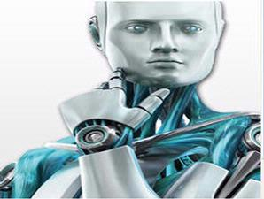
Kerugian
Violation of Privacy
Public Safety
Impact on Labor Force
Health Risks
Impact on Environment
Dampak terhadap tenaga kerja
Walaupun komputer meningkatkan produktifitas dan menciptakan ratusan ribu pekerjaan baru di seluruh industri, keahlian dari jutaan pekerja telah di gantikan oleh komputer

Slide 37
Kerugian
Violation of Privacy
Public Safety
Impact on Labor Force
Health Risks
Impact on Environment
Resiko kesehatan:
Penggunaan komputer dalam jangka waktu yang lama atau tidak dengan cara yang benar dapat menimbulkan cidera atau penyakit

Slide 38
Kerugian
Violation of Privacy
Public Safety
Impact on Labor Force
Health Risks
Impact on Environment
Dampak terhadap lingkungan;
Proses pembuatan dan limbah dari komputer menghabiskan sumberdaya dan pencemaran lingkungan

Slide 39
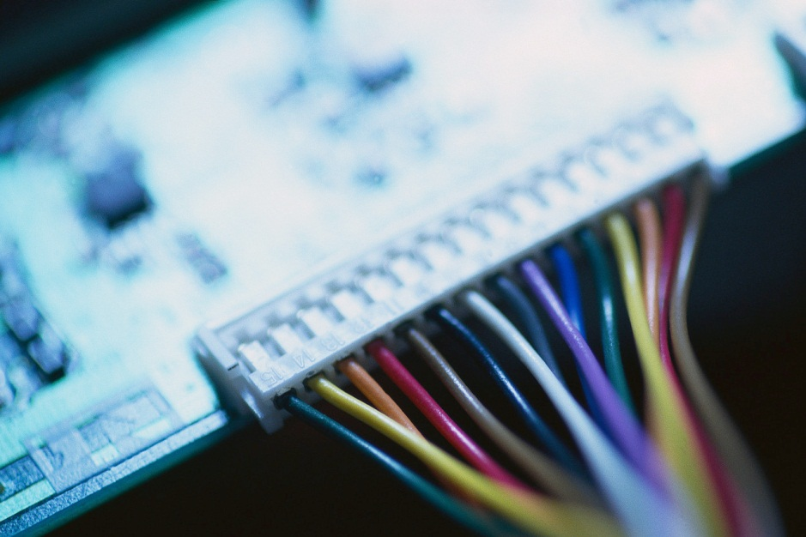
Networks and the Internet
What is a network?
Collection of computers and devices connected together, often wirelessly
Used to share
Resources
Hardware devices
Software programs
Saves time and money
Data
Information

Slide 40
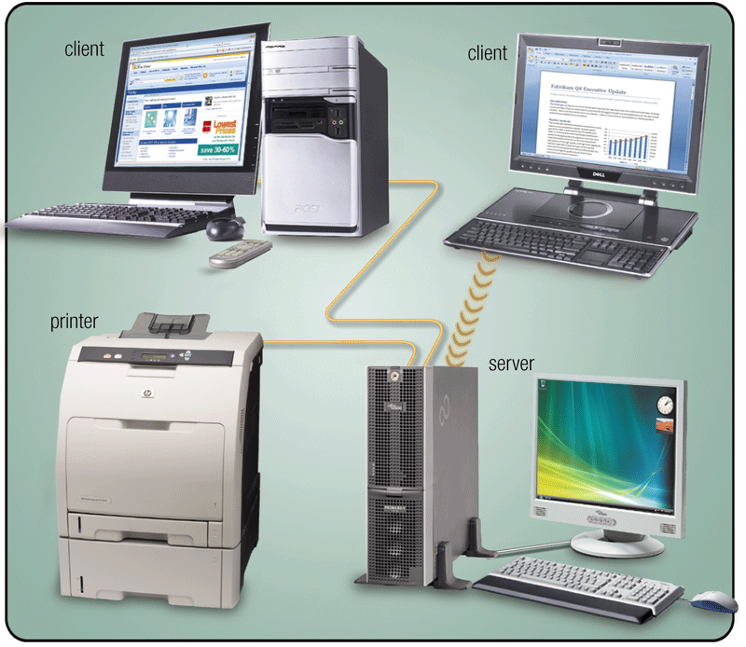
Networks and the Internet
What is a server?
A server controls access to resources on a network
Clients, or workstations, request resources from the server

Slide 41
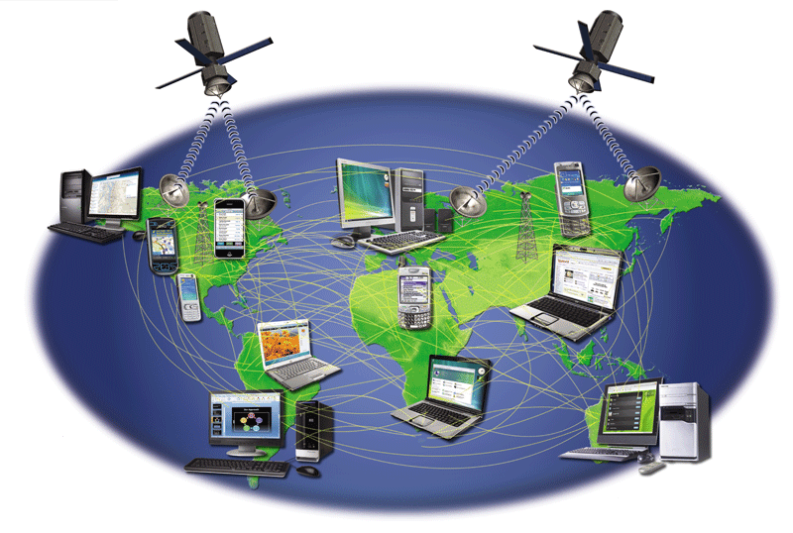
What is the Internet?
Worldwide collection of networks that connects millions of
businesses,
government agencies,
educational institutions,
and individuals

Slide 42
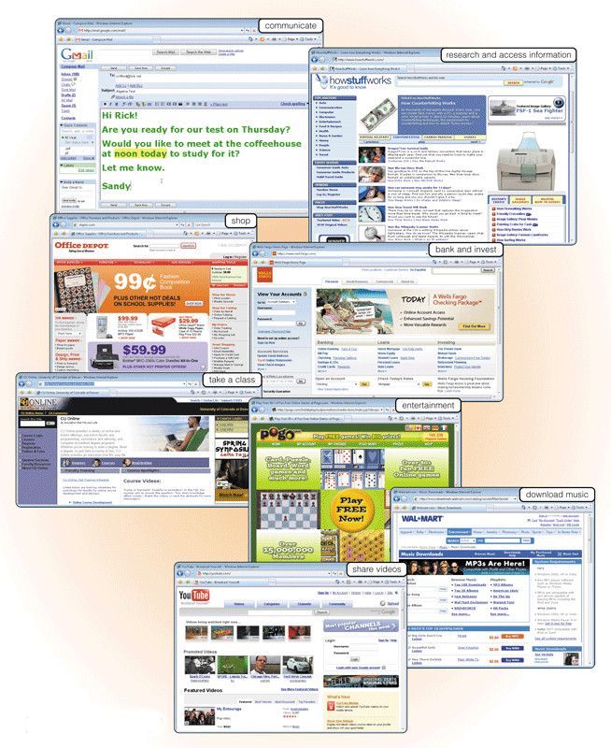
Why do users access the Internet?
Communications
Research and Information
Shopping
Banking and Investing
Classes
Entertainment
Download Music
Share Information

Slide 43
What is the Web?
Billions of documents, called Web pages, available to anyone connected to the Internet
A Web site is a collection of related Web pages
You can share information on a social networking Web site or a photo sharing community
A podcast is recorded audio stored on a Web site that can be downloaded
A Web page contains text, graphics, audio, video, and links to other Web pages
A blog consists of time- stamped articles in a journal format

Slide 44
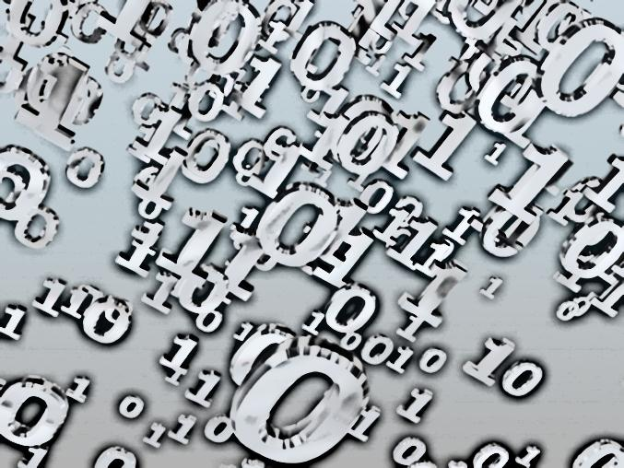
Computer Software
What is software?
Also called a program
Consists of a series of instructions that tells the computer what to do and how to do it

Slide 45
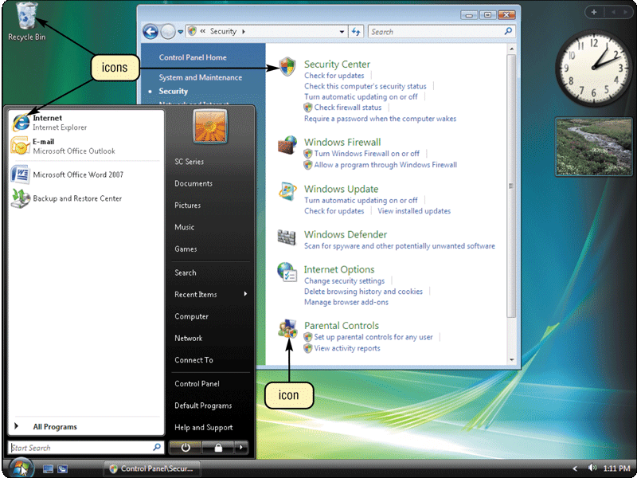
What is a graphical user interface (GUI)?
Allows you to interact with the software using text, graphics, and visual images such as icons
Controls how you enter data and instructions and how the screen displays information

Slide 46
What is system software?
Programs that control or maintain the operations of the computer and its devices
Operating System (OS) is a set of programs that coordinates all activities among computer hardware devices
Utility Programs allow the user to perform maintenance-type tasks usually related to managing a computer, its devices or its programs

Slide 47
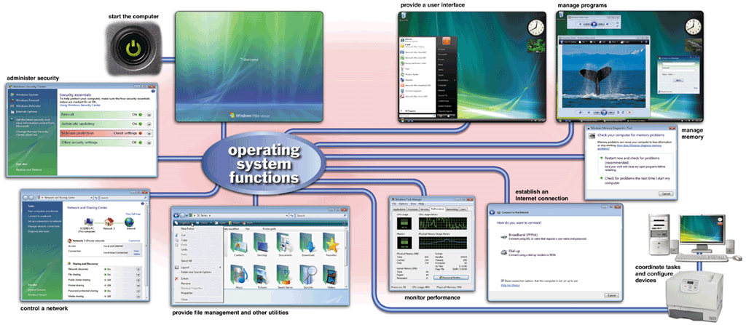
Operating Systems

Slide 48
What are three categories of operating systems?
Embedded
Network
Stand-alone

Slide 49
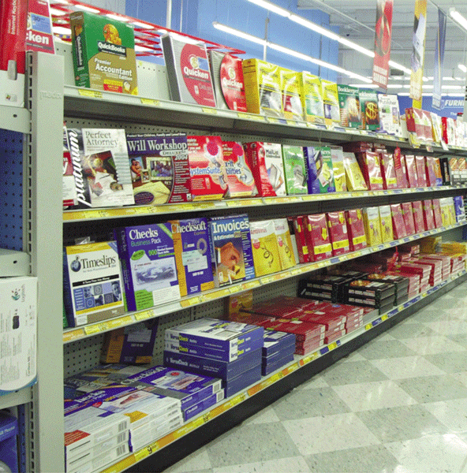
What is application software?
Programs designed to make users more productive
Word Processing
Spreadsheet
Database
Presentation Graphics

Slide 50
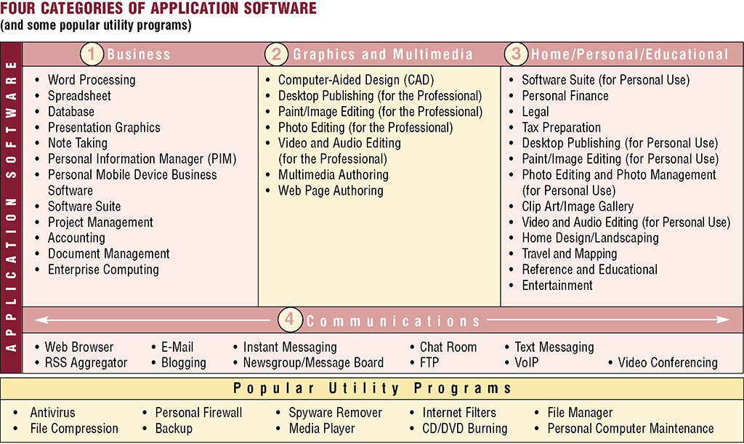

Slide 51
What is a database?
Collection of data organized so you can access, retrieve, and use it
Database software allows you to
Database software also called database management system (DBMS)
Create database
Create forms and reports
Add, change, and delete data
Sort and retrieve data

Slide 52
What is data integrity?
Degree to which data is correct
Garbage in, garbage out (GIGO)—computer phrase that means you cannot create correct information from incorrect data
Garbage in
Garbage out
Data integrity is lost

Slide 53
What are the qualities of valuable information?
Accurate
Verifiable
Timely
Organized
Accessible
Useful
Cost-effective
Informasi yang akurat bebas dari kesalahan
Informasi yang dapat diverifikasi bisa dibuktikan kesalahan atau kebenarannya
Informasi yang tepat waktu memiliki usia yg cocok dgn penggunaannya
Informasi yang teratur dapat memenuhi kebutuhan si pengambil keputusan
Informasi dapat diakses saat dibutuhkan untuk pengambilan keputusan
Informasi Berguna memiliki arti bagi yang menerimanya
Informasi yang efektif memberikan nilai yang lebih dari pada sisi biaya

Slide 54
File Processing Versus Databases
What is a file processing system?
May have weaknesses
Each department or area within organization has own set of files
Records in one file may not relate to records in any other file
Data redundancy—same fields stored in multiple files
Isolated data—data stored in separate files so it is difficult to access

Slide 55
File Processing Versus Databases
What are the strengths of the database approach?
Reduced data redundancy
Improved data integrity
Shared
data
Easier access
Reduced development time

Slide 56

How is software distributed?
Packaged software, mass-produced
Custom software, performs functions specific to a business or industry
Web-based software, hosted by a Web site
Open source software, provided for use, modification, and redistribution
Shareware, copyrighted software that is distributed free for trial period
Freeware, copyrighted software provided at no cost
Public-domain software, freeware with no copyright restrictions

Slide 57
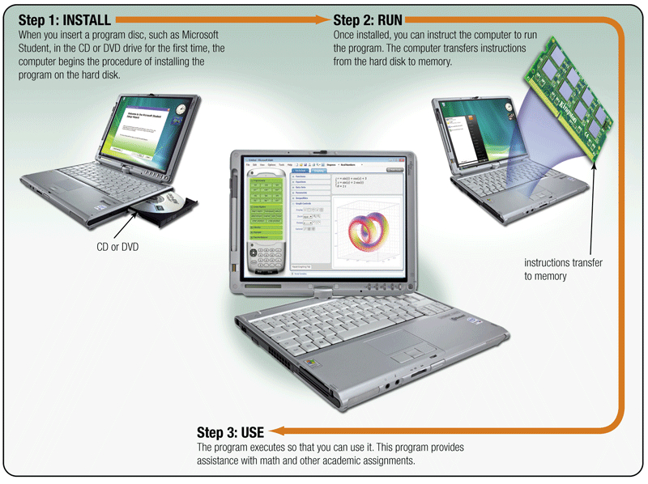
How do you install and run programs?

Slide 58
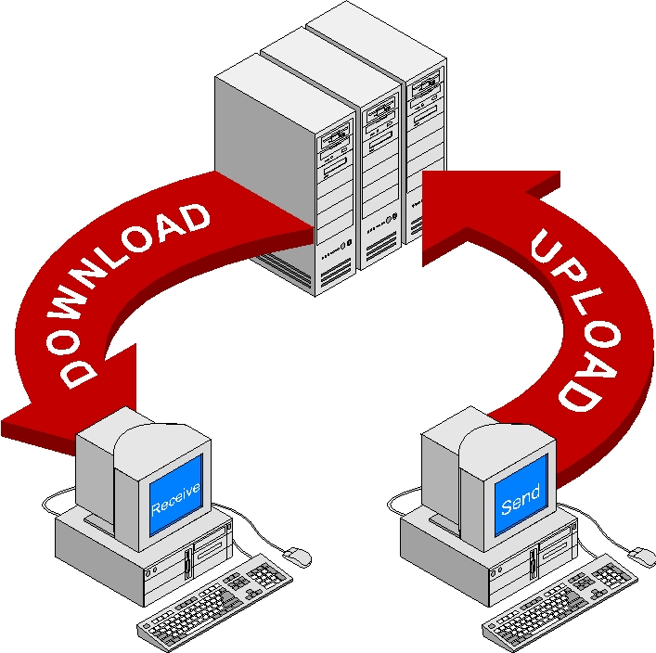

Slide 59
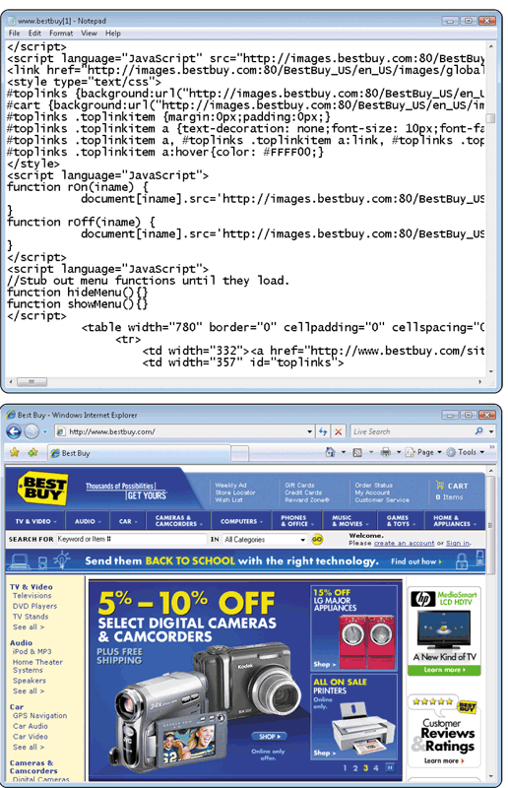
What is a programmer?
Someone who develops software
Programmer writes the instructions to direct the computer to process data into information
JavaScript
Web application

Slide 60
Categories of Computers
What are the categories of computers?
Personal Computers (desktop)
Mobile Computers and Mobile Devices
Game Consoles
Servers
Mainframes
Supercomputers
Embedded Computers

Slide 61
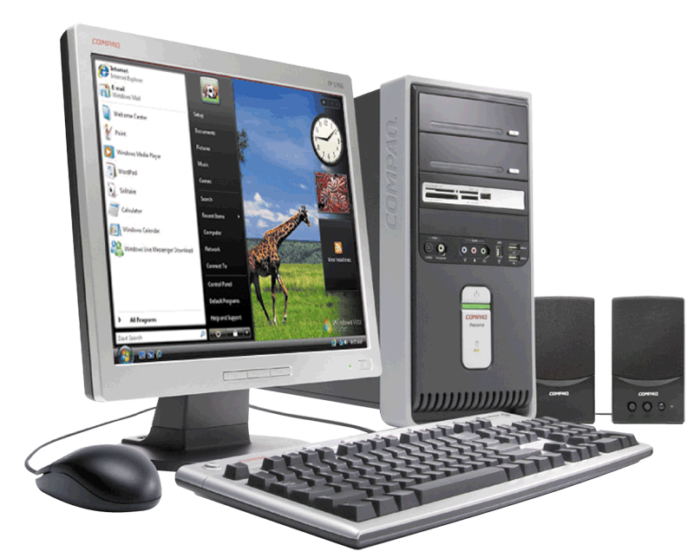
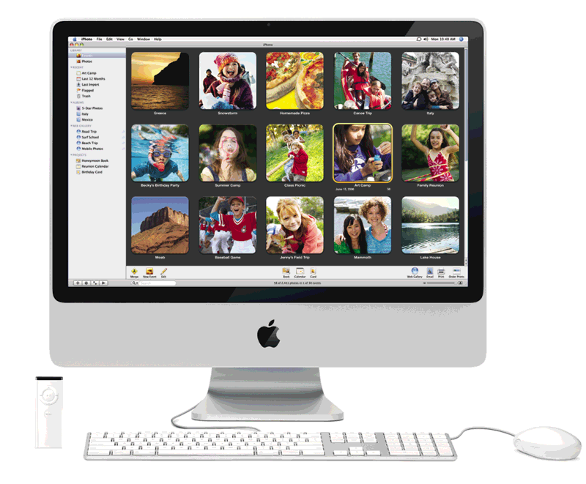
Personal Computers
What are the two most popular styles of personal computers?
PC and compatibles use the Windows operating system
Apple Macintosh usually uses the Macintosh operating system (Mac OS X)

Slide 62
What is a desktop computer?
Designed so all of the components fit entirely on or under a desk or table

Slide 63
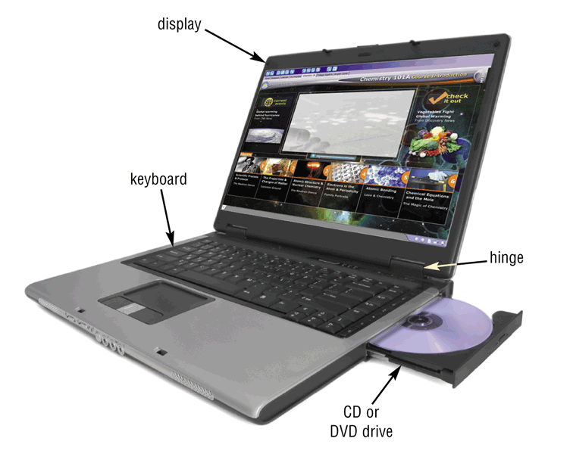
Mobile Computers and Mobile Devices
What is a notebook computer?
Portable, small enough to fit on your lap
Also called a laptop computer
Usually more expensive than a desktop computer with equal capabilities

Slide 64
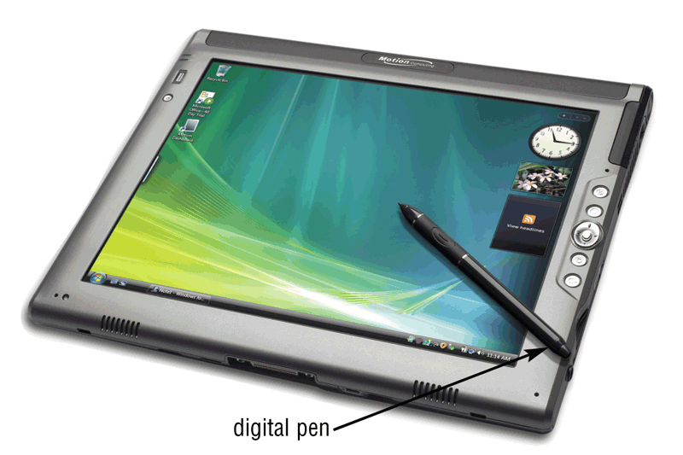
Mobile Computers and Mobile Devices
What is a Tablet PC?
Resembles a letter-sized slate
Allows you to write on the screen using a digital pen
Especially useful for taking notes

Slide 65
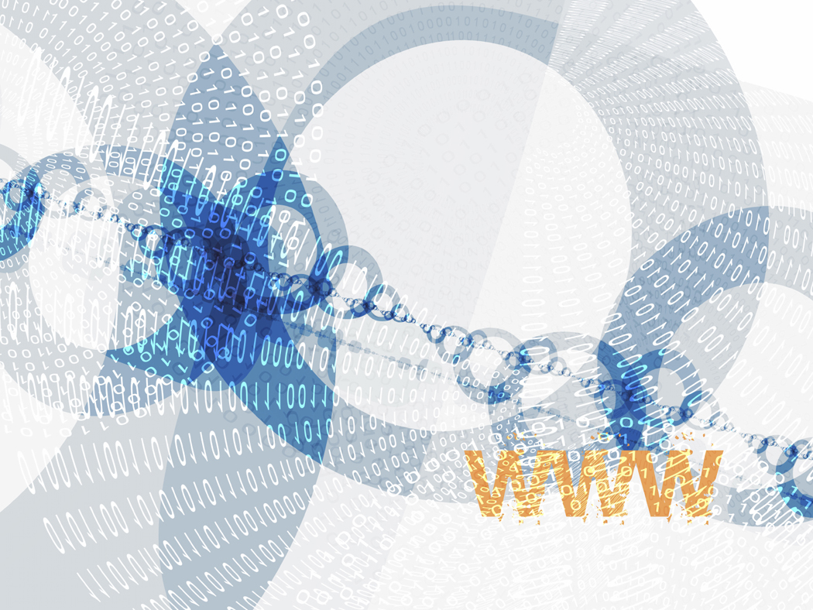
What are mobile devices?
Internet-enabled telephone is a “smart phone”
Small enough to carry in a pocket

Slide 66
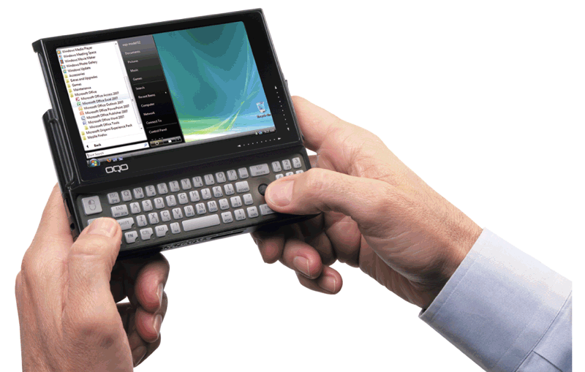
Mobile Computers and Mobile Devices
What is a handheld computer?
Used by mobile employees such as meter readers and delivery people
Small enough to fit in one hand

Slide 67
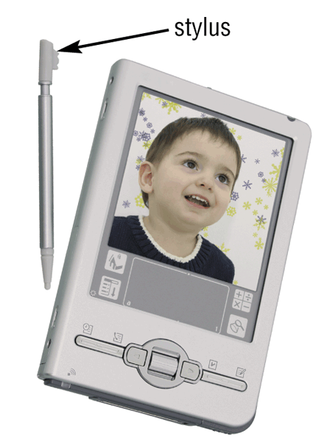
What is a personal digital assistant (PDA)?
Provides personal organizer functions
Calendar
Appointment book
Address book
Calculator
Notepad

Slide 68
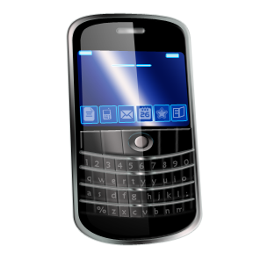
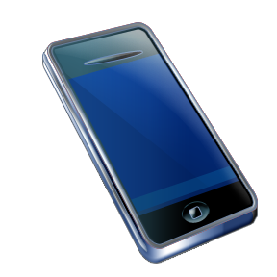
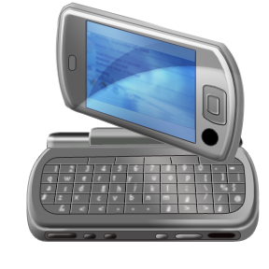
What are smart phones?
Smart phones ?

Slide 69
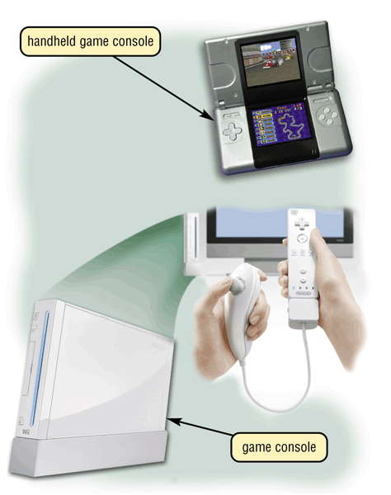
Game Consoles
What are game consoles?
Mobile computing device designed for single-player or multiplayer video games

Slide 70
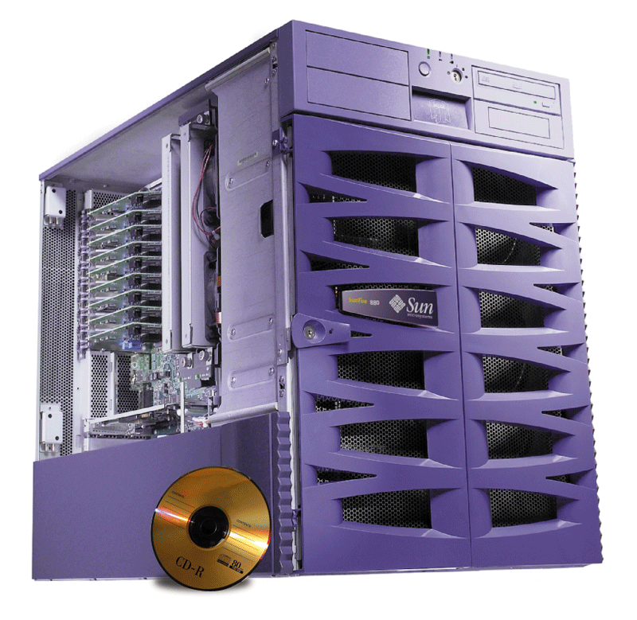
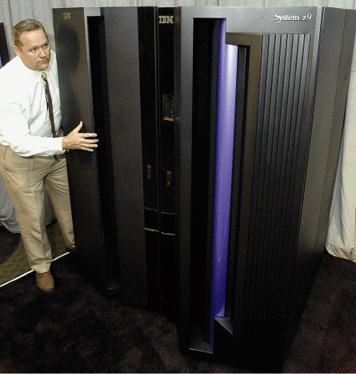
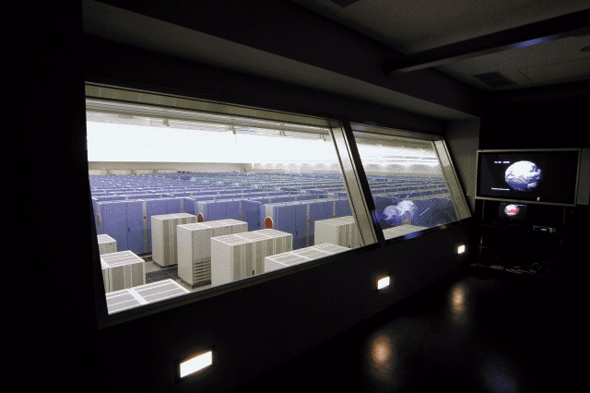
Servers
What types of servers are there?
A server controls access to network resources and provides centralized storage
Mainframe Very powerful, expensive computer that supports thousands of connected users
Supercomputer The fastest, most powerful, most expensive computer. Used for applications requiring complex mathematical calculations

Slide 71
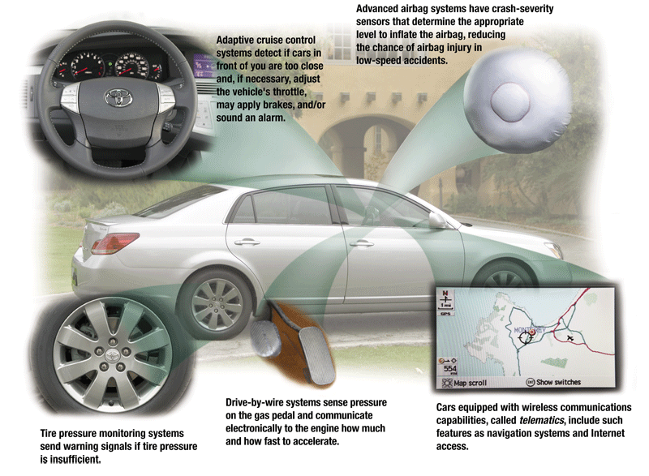
Embedded Computers
What is an embedded computer?
A special-purpose computer that functions as a component in a larger product

Slide 72

Elements of an Information System
What are information system elements?
Hardware
Software
Data
People
Procedures

Slide 73

Examples of Computer Usage
What software is available for a small office/home office (SOHO) user?
Productivity software
Specialty software
Web usage
E-mail

Slide 74

Examples of Computer Usage
What is available for a mobile user?
Hardware
Notebook computers
Tablet PCs
Internet-enabled PDAs
Smart phones
Software
Word processing
Spreadsheet
Presentation graphics software

Slide 75

Examples of Computer Usage
What are the needs of a power user?
Speed and large amounts of storage
Types of power users
Engineers
Scientists
Architects
Desktop publishers
Graphic artists

Slide 76








Computer Applications in Society
What are some examples of computer applications in society?
Education
Finance
Government
Health Care
Science
Publishing
Travel
Manufacturing

Slide 77

Computer Programs
What is a computer program?
Series of instructions that directs computer to perform tasks
Programming language—used to communicate instructions

Slide 78
What is the System Development Cycle?
What is an information system (IS)?
Hardware, software, data, people, and procedures that work together to produce quality information
System—Set of components that interact to achieve common goal
Businesses use many types of systems

Slide 79
The System Development Life Cycle
What are the phases of the system development cycle?
Phase 2. Analysis
Phase 1. Planning
Conduct preliminary investigation
Perform detailed analysis activities:
Study current system
Determine user requirements
Recommend solution
Phase 3. Design
Review project requests
Prioritize project requests
Allocate resources
Form project development team
Acquire hardware and software, if necessary
Develop details of system
Phase 5. Operating, Support, and Security
Phase 4. Implementation
Develop programs, if necessary
Install and test new system
Train users
Convert to new system
Perform maintenance activities
Monitor system performance
Assess system security

Slide 80
Programming Languages
What are low-level languages and high-level languages?
Low-level language
High-level language
Machine-dependent runs only on one type of computer
Often machine-independent can run on many different types of computers and operating systems
Machine and assembly languages are low-level

Slide 81

The Program Development Cycle

Slide 82
Ethics and Society
What are computer ethics?
Moral guidelines that govern use of computers and information systems
Unauthorized use of computers and networks
Software theft
Information accuracy
Intellectual property rights—rights to which creators are entitled for their work
Codes of conduct
Information privacy

Slide 83


Slide 84
Referensi
Computer discovery (2005-2011)
Computer today
Download.com
Youtube
Wikipedia
Sumber-sumber lain dari internet

